Slide 1
Historical Thinking Skills
Mr. Johnson – APUSH

Slide 2
Analysis
Evaluate the P.O.V., purpose, audience, significance and reliability of a source.

Slide 3

Analysis

Slide 4
Interpretation
Understand and assess varying opinions on the meaning of evidence or events.

Slide 5
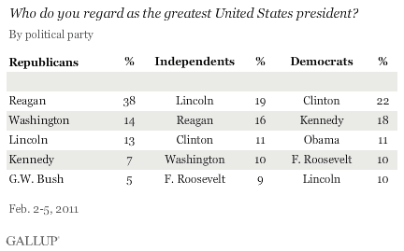
Interpretation

Slide 6
Comparison
Evaluate similarities and differences within or across geography and chronology.

Slide 7
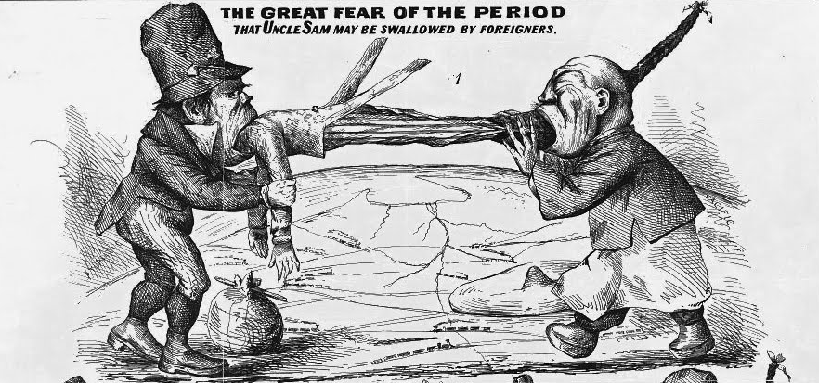
Comparison

Slide 8
Periodization
Understand and evaluate why history is divided into distinct eras with definite start and end dates.

Slide 9
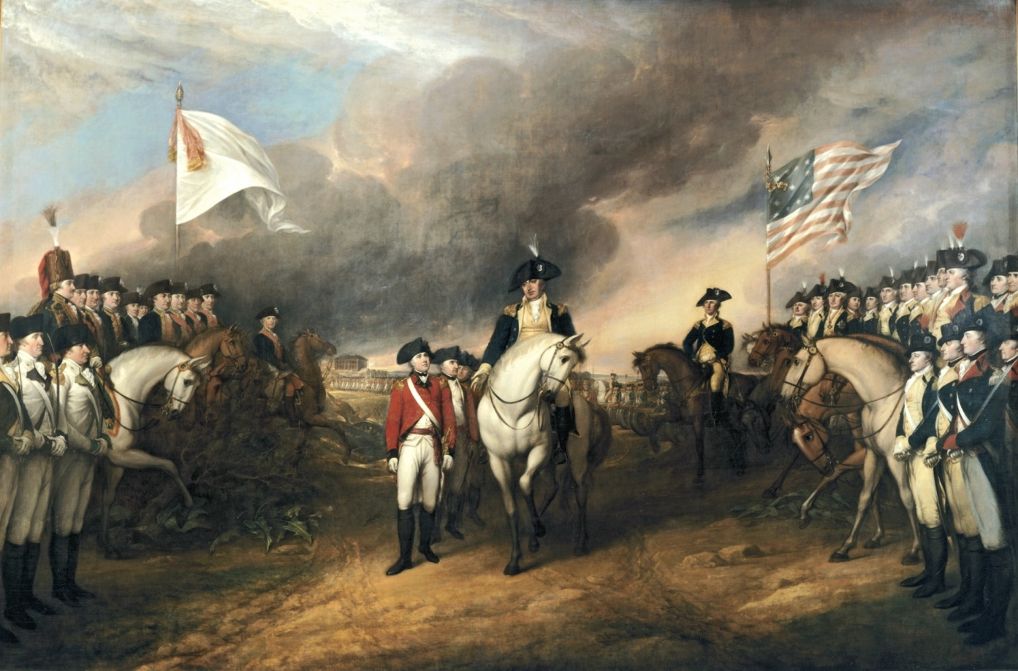
Periodization

Slide 10
Contextualization
Connect events and processes to broader circumstances; situate events within the “bigger picture.”

Slide 11
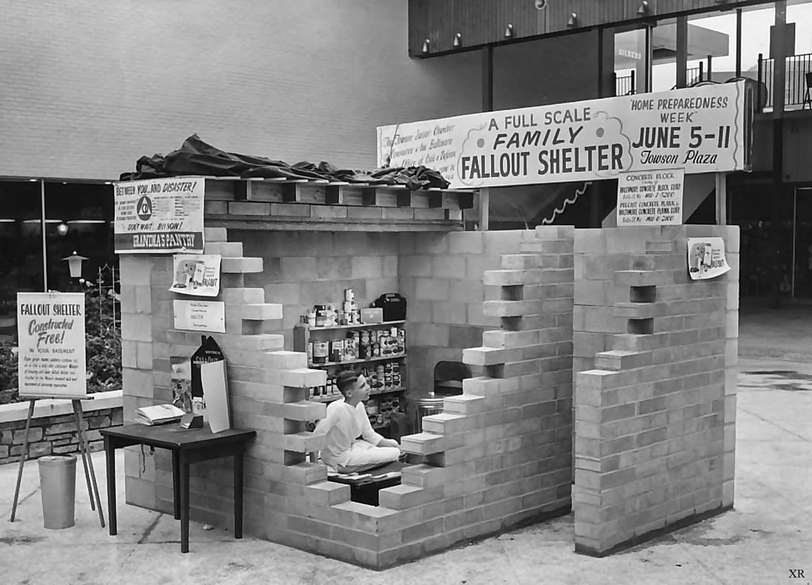
Contextualization

Slide 12
Causation
Explain and evaluate long and short term factors – both predictable and unexpected – which lead to events occurring.

Slide 13
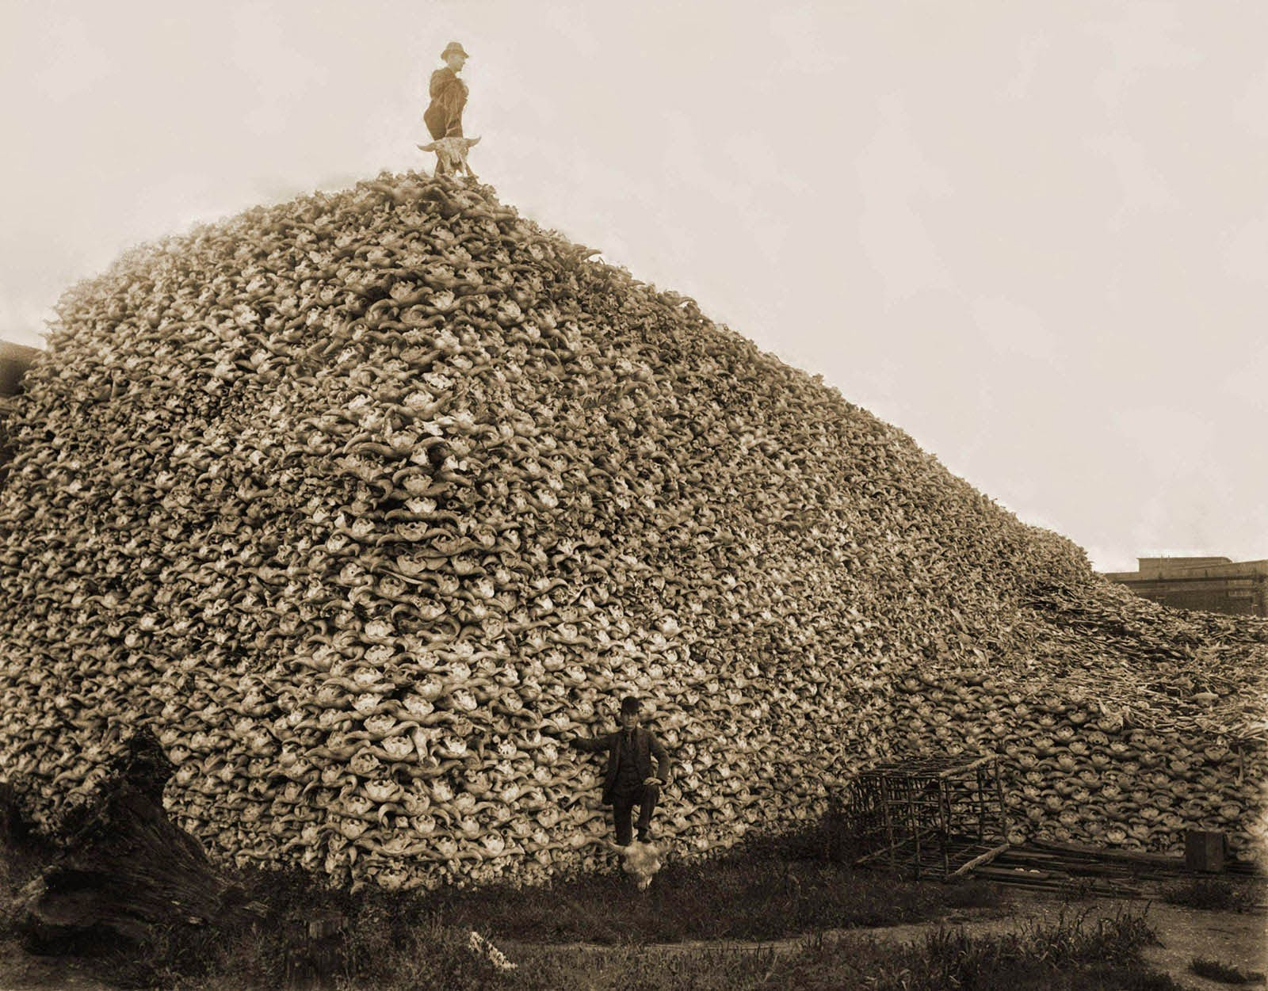
Causation

Slide 14
Continuity & Change
Identify and evaluate consistent patterns as well as alterations to those patterns over time.

Slide 15
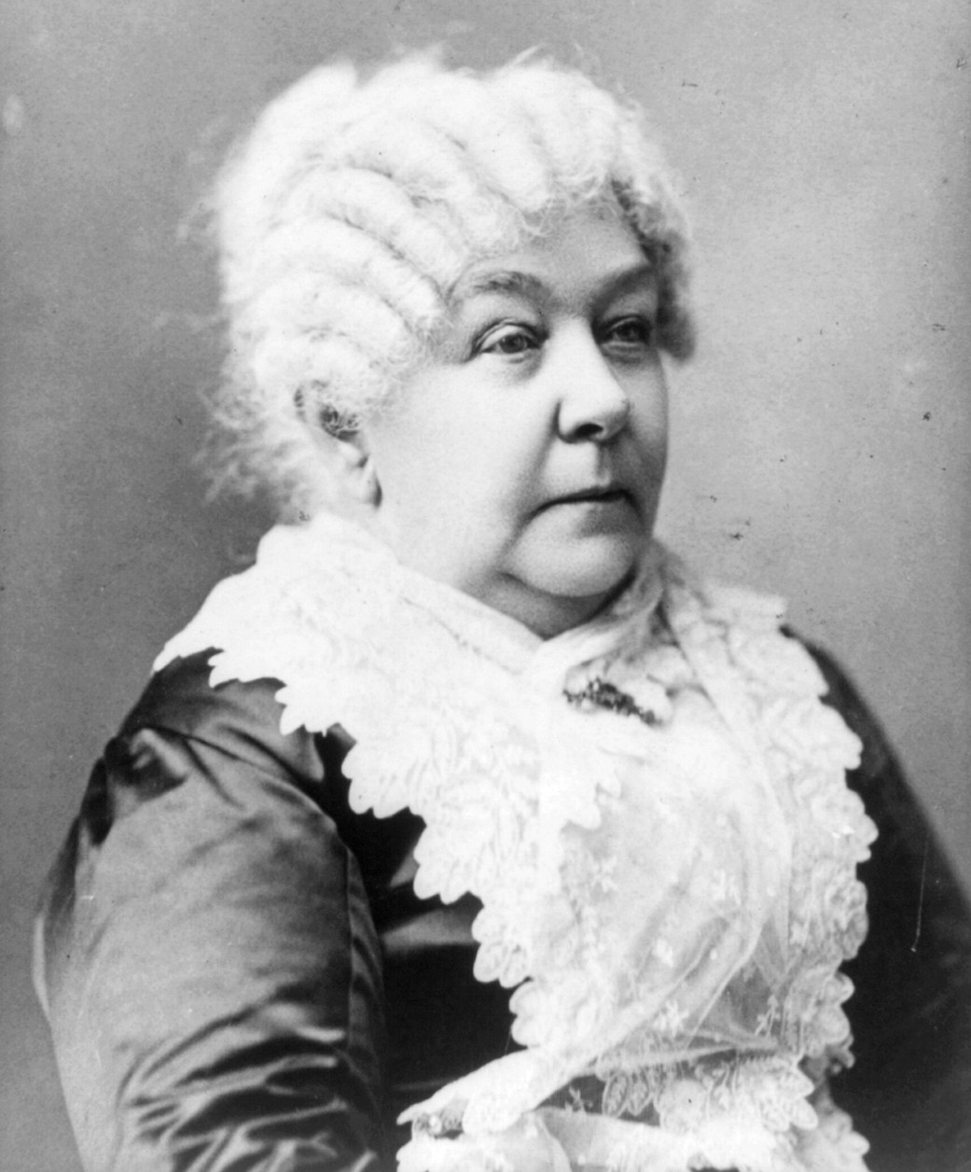

Continuity & Change

Slide 16
Argumentation
Articulate a compelling thesis and support it with multiple kinds of evidence while acknowledging contradictory perspectives.

Slide 17
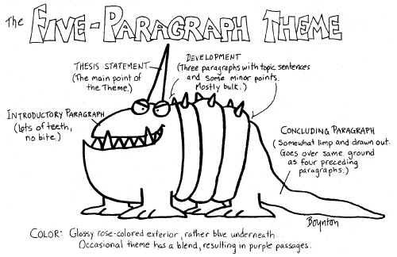
Argumentation

Slide 18
Synthesis
Make connections between various contexts, periods, themes and disciplines.

Slide 19

Synthesis
Ethics
Health
Economics
History
Politics
Science

